Slide 1
Service Fabric – The Real World
Presented By: someone that still plays with cars
https://aka.ms/brent-servicefabric

Slide 2
Service Fabric – The Real World
Presented By: someone that still plays with cars
https://aka.ms/brent-servicefabric

Slide 3
This is your last chance. After this, there is no turning back. You take the blue pill - the story ends, you wake up in your bed and believe whatever you want to believe. You take the red pill - you stay in Wonderland and I show you how deep the rabbit-hole goes.
Morpheus – The Matrix
Notes:
Obligatory quote from someone famous. This seemed as good as anything else.
So what we’re hear to do is peal back the layers on Service Fabric. We’ll go beyond the common introductory and “hello world” scenarios to show you some key aspects of this orchestration framework that will help you build applications for the real world.

Slide 4

Setting Expectations
Beyond “hello world”
Take things to the next level
Getting Real
Explore problems you will need to solve
Less Dev, More Ops
Building services is one thing, management another
Notes:
Introduction
We’re not here to help you install the service fabric SDK or build your first Service Fabric application. You’ve hopefully already done that. In this session, we want to take things to the next level by showing you some things that will be necessary to help you build some real world solutions.
Real World Scenarios
We’re going to explore some topics that aren’t easily found in the getting started documentation. Or at least one’s that don’t always make sense at first. But these represent topics you are likely going to have to explore at some point if you do anything “of worth” with service fabric. We’ll tackle topics like customizing cluster topologies and service placement…. Service endpoint resolution, upgrades, and certificate management.
More Ops
Most of what we’re going to talk about in this session is related to DevOps, that bridge between developing a solution and running it in production. If you aren’t comfortable with this topic, then I’d encourage you to start becoming so. And I’m happy to talk with you at more length about this after this session.
image from: https://thetechbench.wordpress.com/category/client-expectations/

Slide 5
Structure
Customizing Clusters
Node Types & Service Placement
Node and Network customization
Service Discovery and Management
Endpoint Resolution
Rolling Upgrades & Certificate Management
Notes:
We’re breaking today’s session into several sections.
To start, we’re going to talk about what a Service Fabric cluster is, and how we can customize it to suit our own needs. This discussion will center around the concept of Node Types and how we can customize them and even use them to create some interesting cluster topologies.
Next, lets will cover applications and their services. We’ll talk about how we discover and address services, and how we can perform upgrades without downtime and even manage application certificates.
Finally, we’ll discuss moving beyond default services and leveraging the fabric’s orchestration capabilities to instantiate what we need when we need it.
For each of these, we’ll talk for a bit, then (demo gods willing), do a nice little demo to help you visualize what we’ve been talking about.

Slide 6

Service Fabric Cluster
PC/VM #2
Service Fabric
Your code, etc.
PC/VM #3
Service Fabric
Your code, etc. (Port: 19080)
PC/VM #1
Your code, etc.
Service Fabric
PC/VM #4
Load Balancer
Your code, etc.
Service Fabric
Your code, etc.
PC/VM #5
Web Request (Port: 80/443/?)
Service Fabric
Your code, etc.
Notes:
Service Fabric isn’t magic. At its core its an orchestrator. It’s a collection of services working together to help orchestrate processes.
*click* (1)
We start with a series of physical servers or virtual machines, usually inside of a network. These will become the nodes in our cluster. In Azure, this is usually represented by a VM Scale Set.
*click* (2)
To each of these nodes we add the service fabric ‘bits’. The bits are the various command line utilities, executables, and configuration metadata (like our cluster manifest). An Azure virtual machine can leverage an existing VM extension to handle the installation and bootstrapping for you. This gives you the benefit of being able to “inject” the service fabric configuration into each of the nodes.
*click* (3)
With the ‘bits’ installed are boot strapped and use their configuration metadata and start trying to connect with each other. As these connections are discovered and established, the nodes are stitched together into the service fabric cluster.
*click* (4)
With the cluster now operational, we’re likely going to want to be able to route external client traffic to services hosted within the cluster. This is typically done by some type of load balancer or NAT device in front of the cluster.
*click* (5)
If the external client want to reach a service (say the Service Fabric Explorer), on a port (19080 by default)…
*click* (6)
Requests will come in via the load balancer and be routed to the service fabric service which is listening on that port.
*click* (7)
If its one of your own services, running on say port 80 or 443, then you would deploy the application that contains those services to the cluster and again use a load balancer to route the traffic.
One note here… the way you address Fabric services, and your own application services is the same. This is because the fabric “bits” are services running within the cluster. They are managed by service fabric in the same way as your own applications. And in some cases, even use the same Service Fabric services that you use for your applications (such as stateful service replication and service recovery).

Slide 7
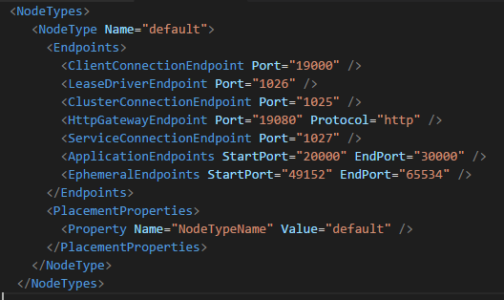
But what is a node?
A single server instance (physical or virtual)
Is a host for Service Fabric managed processes
Contains code and configuration
Grouped into Node Types
A “node type” is a group of nodes with similar properties.
Describes “nature” of nodes for service fabric. Capacity and placement properties, etc
Notes:
Lets pause for just a moment and look at what is a “node” in the cluster.
Simply put, a node is a single server/compute instance that acts as a host for service fabric managed application processes. The node contains the code, configuration, and sometimes data related to the services that are published to the cluster.
*click* (1) But most importantly, nodes with similar physical properties are grouped into “types”. A Node Type is a service fabric construct and is defined by the cluster manifest.
*click* (2)
The cluster’s node type definition (shown here) includes items like the ports that the cluster should be aware of, placement properties (more on those in a bit), and optionally the capacity (memory, disk, etc…) of the nodes of this type. These values are the meta date used by the cluster services on each node and used, among other things, to help determine where to place the instances of the various services.

Slide 8
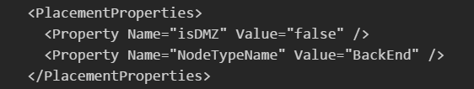
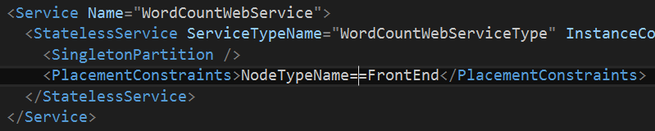
Placement Constraints
Put services where they are needed
Regulatory/security compliance
Hardware specialization
Placement Properties
Declared on the cluster nodes
Placement Constraints
Described by the service
Notes:
As we just mentioned, node type definitions also contain metadata that describe the nodes. This includes capacity but they can also mean different node properties such as “high memory” or “GPU enabled”…. Regardless of what they represent, you need to be able to tell service fabric how to use them determining where services should be placed. We do this by defining Placement Constraints in the service and/or application manifest.
We start on the left by defining the placement properties for a given node type. There’s one default property, “NodeTypeName” which corresponds, as you’d expect, with the name of the node type. But you can add any other key-value you pair you like.
Then, in the right we describe the placement constraints for the services. This example shows it being done in the application manifest. While you can define them in the service manifest, I prefer the application manifest as this allows us to leverage environment specific parameter settings so we can change the value at the time of deployment. Making it very useful when deploying to clusters with different node types and property settings. Say for example your local development environment and a production cluster.
There’s also one special node type property, “isPrimary”. There can be only one of these per cluster. This node type is where the Service Fabric managements services live.
Useful Info:
https://brentdacodemonkey.wordpress.com/2016/09/11/placement-constraints-with-service-fabric/

Slide 9



Hidden Slide – for storing content only
Virtual Network (10.0.0.0/16)
Front End Subnet (10.0.1.0/24)
Front End
Public IP
Front End Node Types
(VM Scale Set)
NSG
Public
Load Balancer
Notes:
Only used to store the layout for the previous slide (which contains a resizable image of this)

Slide 10
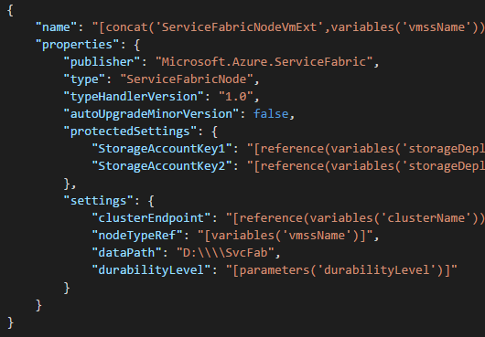
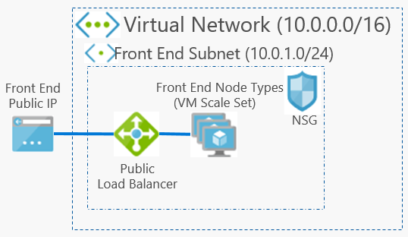
A simple cluster
1 VMSS = 1 Node Type
Placed in a vnet/subnet
Notes:
In Azure, your service fabric will (usually) be hosted on a Virtual Machine Scale Set, or VMSS. This specialized type of VM resource allows us to manage the group instead of the individuals. Adding and removing instances, and each VM instance is the same as the others. If one gets torn down, when its rebuilt it will be exactly as it was when it was first created. For Service Fabric, a node type will be associated with a specific VMSS. And each VMSS can be associated with only one Node Type.
As previously mentioned, we’ll use an extension to “inject” the Service Fabric bits into the VMSS and you can see the reference to the Node Type as part of that extension’s properties.
*click* highlight node type
Now this reference, as you might expect, also needs to be defined to the Service Fabric Cluster (via its manifest). In example we saw on the previous slide, its here *click*
But because the VMSS is just “managed VMs”, they still have to be placed inside of a network and subnet. So a simple cluster, with only one node type might look like this if we looked at it from a network perspective. *click*
This is still a set of nodes that are associated with a node type and hosted on a VM Scale Set. These are placed into a network subnet and fronted by a load balancer. In this case, that load balancer is associated with a public IP address to folks outside of the network can address the cluster, and we’ll use a network security group to secure traffic into and out of the VM’s in the scale set.
Useful links:
https://azure.microsoft.com/en-us/services/virtual-machine-scale-sets/

Slide 11
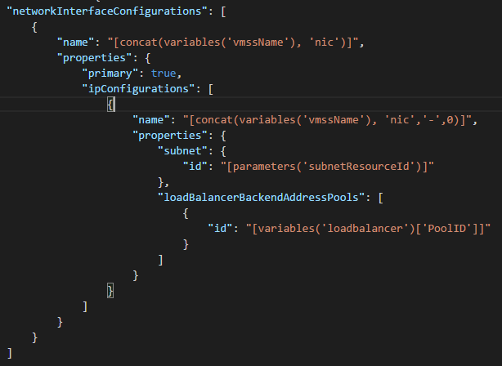
Reuse existing infrastructure
If you have an existing infrastructure, don’t be afraid to use it. A cluster can be placed in an existing network.
A node is just a VM, configure it appropriately
Notes:
I want to note a few things here about the Nodes themselves. The first is that like any other host (physical or virtual), they can be placed in a network that also contains other resources. Even if that network was pre-existing.
In Azure, you may want to associate the nodes in your cluster with a specific subnet in a pre-existing virtual network. When declaring the VM Scale Set, you only need to provide the Azure resource ID of the subnet you want the VM placed is. This goes into the VMSS’s Network Configuration properties. *click*
There’s nothing “magical” about the cluster. Its composed of resources and as such can be treated like any other resource in Azure.

Slide 12
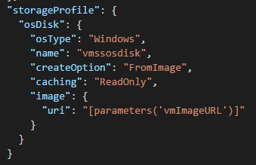
Customize the VMSS OS Image
Why would you want to?
Pre-install necessary components/resources
Streamline startup of the VM
Reduce infrastructure complexity
Steps
Create a VM from a “base” image
Customize the VM
Capture as an image
Deploy “from image”
Notes:
But why stop there, since the nodes are just virtual machines, there’s nothing saying we can’t bring our own VM image to the party.
We can create our own custom virtual machine images. We can pre-install any 3rd party components and thus streamline the startup of the VM. This also reduces the complexity of the infrastructure and its setup by giving us a reusable virtual machine image we can use across environments.
This session isn’t about creating teaching you all the ins and outs of using virtual machine images in Azure. But I do want to drive home that this is nearly as easy as it sounds. Create a Virtual Machine from a base OS image in Azure, Apply your customizations, then capture it as an Image. Finally, we can then tell Azure to create the VM “from” that image.

Slide 13
OS Update & Patching
Azure’s VMSS do not currently support safe and automatic OS update and patching.
OS Upgrade Policy = Automatic
Would take down all nodes of a given node type for an OS Update
Not honored for Service Fabric
Your Responsibility
Script is available today to help with this
An upgrade service for Service Fabric is in the works
VMSS are working on improvements to address this gap.
Notes:
Now for OS Updates…. This is a changing area.
Service Fabric is first and foremost, concerned about your application and services. As such, you need to manage the OS of the nodes in your cluster. In Azure, we use VMSS for the nodes, and as of today, these do not safe, automatic OS update and patching. safely support Now, this doesn’t mean you don’t have any support.
*click* VMSS in Azure have an upgrade policy that helps determine when image updates should be applied to the VMSS instances. Service Fabric requires this policy to be set to “automatic”. While this setting would guarantee that the nodes are all upgrade automatically, it would also mean that all the instances of that VMSS, which is also all the instances of a specific Node Type, would be updated at the same time. It does not currently honor fault and upgrade domains. Its for this reason, as well as others, that this policy is not honored for Service Fabric related resources.
*click* For today, OS update and patches are your responsibility. There are a set of scripts that can be used to perform these upgrades. Which means that you’re going to want to create a plan for this and ensure you’re prepared to execute it. In the coming months, we’ll be rolling out an upgrade service that will help simplify this. And we are actively working to help address this gap with the VMSS product group.
A patching service is in the works for CY17. This will help make this much easier. Additionally, we are also working on enhancements to the VMSS to further improve this story.
Useful Info:
https://blogs.msdn.microsoft.com/azureservicefabric/2017/01/09/os-patching-for-vms-running-service-fabric/
https://docs.microsoft.com/en-us/azure/virtual-machine-scale-sets/virtual-machine-scale-sets-upgrade-scale-set
https://msftstack.wordpress.com/2016/11/15/azure-scale-set-upgrade-policy-explained/

Slide 14

A “DMZ” Cluster
Virtual Network (10.0.0.0/16)
Front End Subnet (10.0.1.0/24)
Back End Subnet (10.0.2.0/24)
Front End
Public IP
Front End Node Type
(VM Scale Set)
Private
Load Balancer
(10.0.2.4)
Three node types
Three Subnets
Public IP w/ Load Balancer
Private IP w/ Load balancer
Fabric services isolated from application services
NSG
NSG
Public
Load Balancer
Back End Node Type
(VM Scale Set)
Management Subnet (10.0.3.0/24)
Management Node Type
(VM Scale Set) primary=true
NSG
RDP Jump Box
Public
Load Balancer
Management Public IP
RDP Jump Box Public IP
Notes:
By leveraging these concepts, we can start creating Service Fabric cluster’s that meet the unique needs of our solutions.
Lets take one such example. Assume that for regulatory reasons, you need to create network isolation between services. This could be regulatory, it could be due to organization network requirements/standards. Whatever the reason, we can leverage the VM Scale Sets to help achieve this. We configure each VM Scale Set to be placed into a different subnet. Furthermore, we can then start leveraging a mix of public and private load balancers to help with directing traffic appropriately.
In this example, we’re also going to segregate the service fabric services from the other services. In the “management” subnet we’ll place our “primary” nodes. This technique is used in situations where you want to help restrict access (at a network level) and to help reduce the risk of service resource congestion.
Lastly, to ensure that the services deployed to the cluster land in the correct locations, we’ll leverage the node types, and specifically their placement properties.
Useful Info:
http://brentdacodemonkey.wordpress.com/2016/08/01/network-isolationsecurity-with-azure-service-fabric/

Slide 15
Ports Required (by default)
Service Fabric Ports
Cluster Management: 19000, 19080
Reverse Proxy: 19008 (if enabled)
SMB: 445 (used by the application store)
“Fabric” services: 1025-1027
Service Fabric Ports
Ephemeral: 49152-65534
Application: 20000-30000
Notes:
When you start creating more complex clusters like this, you’ll also need to be aware of which ports are required between the nodes. Its important to note that most of these can be adjusted via the cluster manifest, so what we’re showing you here is the “default” ports.
Cluster Management is the “explorer” web portal and TCP management (used by things like powershell and cli).
*if* you’ve enabled the reverse proxy, you’ll need to allow 19008. But most of the time you’ll be accessing this via local host, so you can scope this based on your usage.
The SMB port of 445 is used by service fabric to move the application packages between nodes. So this needs to be open of publishing will fail.
The “fabric” services require ports 1025-1027 for connections between the clusters and their “fabric” system services. (cluster connection, service connection, lease driver).
The Ephemeral and Application ports are assigned for dynamic application ports and used for replication operations of stateful services.

Slide 16
Troubleshooting
Remote Access
System Logs
Service Fabric Logs (D:/SvcFab/Log)
Azure Activity Log
Useful for deployment errors
Online Support
Stack Overflow, MSDN Forums, Azure Support
Notes:
When we customizing out clusters, we’ll invariable run into problems. When this happens, there’s a few things to reach for.
First and foremost are the nodes. Since Service Fabric is just bits on a server, access to that server is usually our first and best option. This is why its important to have a way to remotely access the servers. Once we have access to the server we can check the system logs for errors (which can occur if there’s an issue with the Service Fabric installation), or Service Fabric’s own logs. In some cases, you’ll even find that the service fabric location isn’t even there in which case there’s definitely a critical failure of the installation.
If you’re deploying to Azure, also make sure you check the Azure Activity Logs. While this won’t show you something inside of the nodes, it will tell you if there was a problem with deploying the Azure resources.
And finally, if you find an error and need help tracking down what it means… don’t hesitate to look for answers or assistance online. Stack Overflow and the MSDN Forums are monitored by the Service Fabric team and various other experts. And there’s also always the option to open a support ticket directly from the Azure Portal.

Slide 17
Cluster Sizing & Scaling
Cluster Sizing
An exercise in continuous testing/validation
Don’t assume it will always remain constant
Take sizing of packages and logs into account
Scaling Up & Down
Scaling done by Node Types (VMSS)
Scaling up is easy, scaling down not so much
Avoid scaling jitter
Notes:
These two topics are complicated. So much so that to truly do them justice, they’d likely need at least an hour on their own and a day long workshop to help get everything covered appropriately.
For sizing, simply put… you need to test and validate. Each application and service that gets added to the cluster puts load on it. Each of the underlying services you leverage (reverse proxy, replication etc…) add load to the cluster. So you will need to deploy your application and test it to find out what you really need. This exercise isn’t really any different then the way you’d size it on premise. However, if you’re running in the cloud you hopefully have the advantage of not having to commit to your hardware capacity for the first 5 years before you ever built the system.
With that in mind, you’ll also want to monitor things post launch. Over times, systems grow, and in production scenarios there are always surprises. So please put measures in place for ongoing monitoring of the system.
And lastly, note that each application you add to the system adds its own package size to the store on each node, and when the services are deployed they will generate log files. These logs will be cleaned up over time by Service Fabric, but when testing you sizing, you will want to look at it over time.
For scaling… scaling is done by the Node Type (VMSS). When a new node instance is added, it will eventually be added to the cluster automatically. This isn’t instantaneous, and will take some time. So be patient.
Scaling down is a bit more complicated. You have to manually remove the nodes from the cluster, let the cluster adjust, them you can remove the VM instance. He steps to do this are to disable the service fabric node, wait for the disable to complete, then “scale down” the VMSS cluster. You will always need to do this going from the “hightest instance” down.
One word of caution here, and this applies to both scaling the cluster as well as rebalancing services. Avoid “jitter”. Service fabric is capable of making adjustments very quickly. But these adjustments put load on the system. If you are constantly adjusting things back and forth, this puts a significant load on the system overall. Don’t adjust for short term transient issues, give short lived items a chance to correct, then only adjust when we have significant need to do so.
Useful links:
https://docs.microsoft.com/en-us/azure/service-fabric/service-fabric-cluster-scale-up-down
https://docs.microsoft.com/en-us/azure/service-fabric/service-fabric-cluster-capacity

Slide 18
Lets take a look…
Placement
Content © Microsoft
Notes:
Look over the solution in Visual Studio, highlight the placement constraints and parameter files. Show deployed the local “dev” cluster, and to a remote cluster. Explore the remote cluster with all its different properties.
Prep:
Install Visual Studio and Service Fabric SDK on machine that will be used for the demo
Configure the local cluster as a 5 node cluster
- Pull down https://github.com/brentstineman/PersonalStuff/tree/master/ARM%20Templates/unsecureSvcFabClusterWithDMZ and build the project
Deploy the project to the local cluster
Set up an Azure hosted cluster using the unsecure DMZ cluster template at the above link.
Create a “cloud” application parameter file for the DMZ cluster to put the two apps in different subnets
Demo Script:
Show Service Fabric Application in Visual Studio
Highlight two applications and use of placement properties
Show parameter files
Show local 5 node dev cluster
Show application in place on the 5 node cluster
Deploy the app to the cloud using the “cloud” parameter file
Show the DMZ Cluster
Show in the Azure portal. Highlight the VMSS’s and Vnet
Go to the Fabric Explorer and show the 3 different node types
Show “node types” in the cluster manifest
Show the “system” services are only on the primary nodes
Show the deployed application only being applied where the placement constraints exist.
Show the application instances on the proper nodes
Highlight that the Fabric Explorer and “Application” are on different Ips

Slide 19
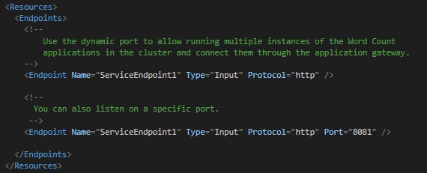
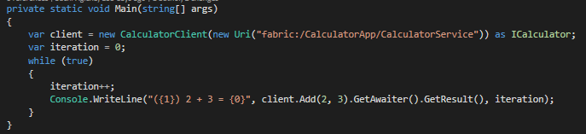
Service Port Assignment
Endpoints are declared in the service manifest
The “Port” is optional
Benefits
Use cluster’s application range
Avoids port collisions
Resolve via the Reverse proxy or Naming service
Notes:
Ok, hopefully the cluster seems a bit less magical now. So lets move on to the services in the cluster.
When you deploy a service to a cluster, if its going to be listening for inbound requests, you need to declare one or more endpoints. This declaration is typically done in the service manifest and used when the service is “registered” with the cluster’s application store. When declaring the endpoint, you have to give a protocol (http or tcp) and the type (input or output). Optionally, you can also specify a port that the service will be listening on.
Its this “optional” port I want to talk about for a moment. You certainly leverage this. In fact, if you’re accepting requests from outside of the cluster, you’re likely going to want to do this because you’re also probably using a load balancer of some time to direct external traffic to the cluster. And that port is something that load balancers usually need to know when directing traffic. So what happens if you don’t specify a port? Service Fabric will assign one to each instance of the service.
This usually leads to two questions… the fist is “what is the benefit” and the second is “how do I address the service”?
*click*
If you don’t specific a fixed port, service fabric will allocate a port from the “application port range” defined in its manifest. This allows service fabric to help avoid any port collisions. So two services, or even two instances of the same service, can both live on the same node within the cluster in (hopefully) perfect harmony. Something we couldn’t do if we used a fixed port of say ’80’. How many times have you tried to deploy something only to find there was already something running on your designated port? Well service fabric can help us avoid that altogether.
When the question comes about how to resolve an endpoint.
*click* This is the another feature of the naming service.
What you see here is a custom class that implements the ServicePartionClient and ClientFactoryBase classes. These classes interface with the naming service to resolve the endpoint of a service (in this case “fabric:/CalculatorApp/CalculatorService”), as well as handle common communication challenges like transient fault handling and retry. If you like, you can go even deeper, and not use these classes and instead get right to the heart of the naming service, but lets not get that deep into the weeds. At least for this session.
Useful links:
https://docs.microsoft.com/en-us/azure/service-fabric/service-fabric-connect-and-communicate-with-services#service-discovery-and-resolution
https://docs.microsoft.com/en-us/azure/service-fabric/service-fabric-service-manifest-resources
https://docs.microsoft.com/en-us/azure/service-fabric/service-fabric-reliable-services-communication#communicating-with-a-service
Sample:
https://github.com/Azure-Samples/service-fabric-dotnet-getting-started/tree/master/Services/WcfService/Calculator.Client

Slide 20
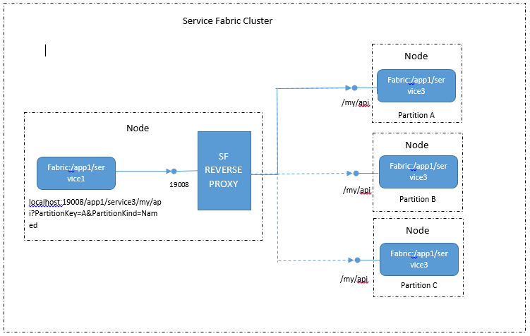
Reverse Proxy
Things to Know:
Must be set up on the cluster in advance
Exposes ALL services on the cluster
Only does basic “round robin” routing
Does SSL termination (no HTTPs on the “back end” currently)
localhost:19008/app1/service3/my/api
Notes:
If that isn’t enough, there’s another route to reaching services. Service Fabric includes a built in reverse proxy which you can choose to deploy if you so desire.
*click*
Addressing a service via the reverse proxy is as simply as directing traffic to localhost on the port you specified when the cluster was set up (19008 by default) with the application, service, and application. In this example we’re talking to *click* localhost:19008/app1/service3/my/api. “app1” is the application, “service3” is the service. “my/api” is the route for the endpoint.
Requests can be either tcp or http and are simply forwarded to an instance of the service as determined by the naming service.
Now there are a couple things you need to know about using the reverse proxy *click*
there’s no way to add the proxy to a cluster once its been set up. Adding the reverse proxy is a “setup” time decision
The proxy exposes all the services on the cluster via port 19008. And it provides zero access control. So I wouldn’t recommend putting it on the other end of a public load balancer.
Lastly, the reverse proxy, does not take into account the load on a given service instance. Its only going to due the most basic round robin routing. With most load balancers you can specify a probe that can be used to help a service tell the LB not to direct traffic when its under stress (by responding appropriately). The reverse proxy does not have this capability.
Lastly, when using SSL for a service, the reverse proxy does SSL termination. There’s no way to address “https” on the back end currently. Additionally, the proxy will use a single certificate.
Useful links:
https://docs.microsoft.com/en-us/azure/service-fabric/service-fabric-reverseproxy

Slide 21
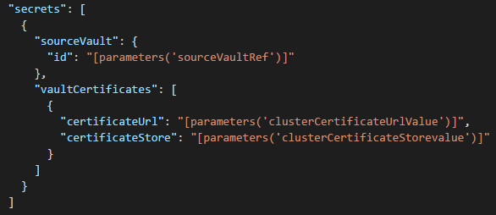
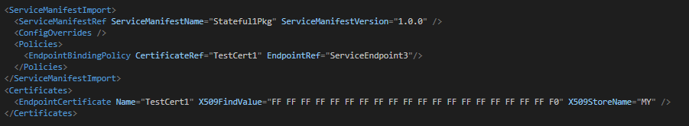
Application Certificates
The Cluster (VM Scale Set)
Add the certificate to Azure’s Key Vault
Declare to the VMSS (including where to put it)
For the service, its declared in the application
Certificate is declared with its thumbprint and the store name
Bind the endpoint to the certificate
Notes:
So… Speaking of certificates… how do we do application certificates? I’m going to discuss this in terms of an Azure managed cluster. In part because its slightly more complex, but also because if you can get it in Azure, doing it with a self-managed cluster should prove easy.
*click* Because the cluster is really just a collection of VM’s. We’ll start with getting the certificates into them. There’s a bit of detail here, and there’s a link to a detailed version of this in the presenter notes of this deck. So we’ll go over this quickly. We start by adding our certificates to an Azure Key Vault’s that has “azure deployment” enabled. This gives us a safe, online storage location for the certificates that can be referenced by Azure when we create/update our VMSS. *click* This is considered a secret for the VMSS.
What we have here is a snippet of an Azure Resource Manager (ARM) declaration for VMSS. It takes a reference to the Key Vault where the certificates are stored, and we then specify the individual certificates within that store we want, and where they should be placed on the VMSS instance. If you are doing this to a self-managed VM, you would simply install the certificate yourself using whatever approach you are most comfortable with. Be it an orchestrator like Chef or Puppet, remote powershell, or even manual setup by an operator. But because we’re dealing with Azure’s VMSS, we need to use this approach to ensure that any new VMs that are added, or ones that have to be “rebuilt” stick to our pre-defined configuration.
Azure Resource Manager and VMSS are again topics we could spend significant time on. So feel free to catch me afterwards to talk about this more. ☺
*click* Now for the application, we will start by declaring the service as having an ‘https’ endpoint. This is the same types of declarations we saw earlier when discussing ports. So I won’t show that again. But if we declared the endpoint as ‘https’, we’ll now want to leverage the application manifest to “bind” that endpoint to our certificate.
*click* we start by adding the certificate to the manifest. We’ll use the thumbprint for the certificate in question, and the store where its at.
*click* with that in place, we’ll then bind the certificate to the endpoint. The two “ref” properties here must match what we declared for the endpoint certificate, and the service endpoint.
Useful links:
https://docs.microsoft.com/en-us/azure/virtual-machine-scale-sets/virtual-machine-scale-sets-faq#certificates
https://docs.microsoft.com/en-us/azure/service-fabric/service-fabric-service-manifest-resources#example-specifying-an-https-endpoint-for-your-service
https://docs.microsoft.com/en-us/azure/service-fabric/service-fabric-cluster-security-update-certs-azure#adding-or-removing-client-certificates

Slide 22
Application and Service Upgrades
Upgrade Domains
In stages, one domain at a time
Code changes impact the application hosting process (impacting other services)
Breaking Changes
Health Checks
Specified in the optional “policies” section of the application manifest
Describes both “default” and service specific settings
Sets thresholds for maximum percentage of unhealthy: partitions, replicas, or services
To prevent a breaking change, services need to be compatible with +/- 1 version of their current.
Multiple Upgrade Types
Monitored: health of each upgrade domain checked before proceeding
Unmonitored Auto: on upgrade domain at a time, no health check
Unmonitored Manual: lets administrator upgrade one domain at a time
Notes:
If you watched various videos about service fabric, as some point you’ve likely see a demo of a “live upgrade” of an application. There’s nothing especially “magical” about this process. But I do want to spend a few moments to cover some of the basics.
*click* Upgrade Domains
When performing upgrades to service fabric applications/services/partitions, service fabric will leverage the defined upgrade domains. These were set at the time the cluster was created (in the cluster manifest). These are the same upgrade domains are also used when the cluster determines the placement of service partitions and replicas. However, we need to keep in mind that when we’re updating code, the host process is also impacted. And this in turn could impact other services within that same application. But service fabric knows this as well, and therefore takes this into account when placing all the services for a single application.
*click* Health Checks
When an the application service/partitions in an upgrade domain have been updated, an optional health check can be performed. Based on the policies defined in the application manifest, service fabric will make sure that the minimum percentage of the instances/partitions in that domain are “healthy” before it moves on to the next domain. These limits are defined in optional policy section of the application manifest as both defaults, and service specific values.
Its important to note that service fabric won’t really know what “healthy” means for your individual service. So its important that you instrument your services with custom health events.
*click* Multiple Upgrade Types
When doing an upgrade, you have three different types to choose from.
Monitored (the default and recommended approach), will do one upgrade domain at a time, and verify the health checks pass before proceeding on.
Unmonitored “Auto” does them an upgrade domain at a time, but doesn’t bother with waiting for the health checks.
Unmonitored “Manual” is administrator controlled, allowing for an operator to determine when to do each upgrade domain.
There’s technical a fourth option of “upgrade everything right now”. But that’s not something we would ever recommend for a production service. ☺
Now admittedly, you could easily do an hour long presentation on just what’s discussed in this one slide. But we don’t have time for that, so I would encourage you to explore this topic at your leisure using the links that are included in this slide’s presenter’s notes. But there’s one last item I want to touch on here….
*click* Breaking Changes
For any of this to work with zero downtime, we need to be sensitive to breaking changes. At any point during an upgrade, a remote client could be connecting to either the new version of the service or an older one. You could make the argument that it’s the client that needs to be compatible, but right now we’re talking about upgrading our service. And as such, I want to call out that if its your service, its also your responsibility not to break clients that depend on you. Be they internal or external.
Useful links:
https://docs.microsoft.com/en-us/azure/service-fabric/service-fabric-application-upgrade
https://docs.microsoft.com/en-us/azure/service-fabric/service-fabric-application-upgrade-tutorial
https://docs.microsoft.com/en-us/azure/service-fabric/service-fabric-application-upgrade-parameters
https://docs.microsoft.com/en-us/azure/service-fabric/service-fabric-health-introduction
https://docs.microsoft.com/en-us/azure/service-fabric/service-fabric-diagnostics-how-to-report-and-check-service-health

Slide 23
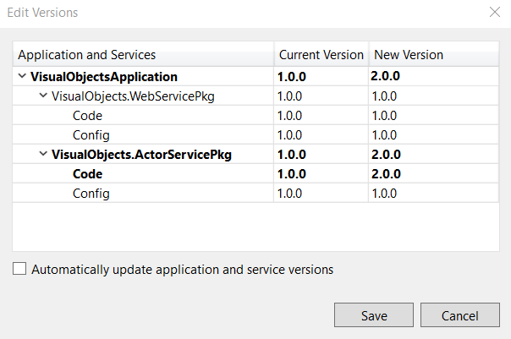
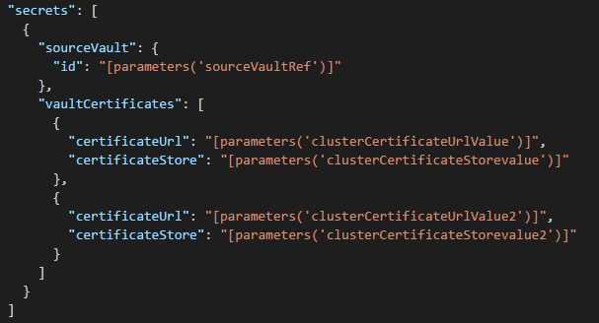
Certificate Rotation
Add a new certificate to the nodes
Add it to the key vault
Update the VMSS to reference the new certificate
Update the service
Update Application Manifest
Increment the version
Publish and deploy the upgrade
Notes:
Ok, we’ve covered certificates, as well as application upgrades. So lets combine those two topics to update a certificate.
*click* we start by adding the certificate to our nodes.
Just like we did before, we start by adding the certificate to the Azure Key Vault. With the certificate in place, we then update the VMSS configuration to add the new certificate. *click*
If you’ve done any java coding, you’ll notice that in ARM we use JSON notation to describe the resources we’re creating. In this case “valutCertificates” is an array. And all we’ve done is add a second object to that array that describes the new certificate. We add a second certificate because this update will be completed before we update the application’s bindings. So its important that the we don’t remove the old certificate until we know its not in use any longer.
*click* with the new certificate now in place, we’ll update the service.
We update the application manifest, changing the thumbprint that’s associated with our binding to the new value and optionally the new certificate store. *click* Next, we increment the version of the application and/or service. With these changes complete, we then publish the updated application and deploy it to the cluster much like we did before.
Useful links:
https://docs.microsoft.com/en-us/azure/service-fabric/service-fabric-cluster-security-update-certs-azure
Image from: https://docs.microsoft.com/en-us/azure/service-fabric/service-fabric-application-upgrade-tutorial

Slide 24
Lets take a look…
Live, Inplace Upgrade
Content © Microsoft
Notes:
Do certificate rotation for an application certificate on the cluster. Show running upgrade.
Prep: (the same app and cluster used in the first demo can be reused)
Generate 2 self signed certificates with different names
Add the certificates to key vault
Create a hosted Azure cluster
Have both certificates referrenced
create a simple ASP.NET application with an https endpoint
Associate the app with one of the certificates
Deploy the application to the cluster
Demo Script:
Show the application in a browser
Highlight the certificate in use
Show the Azure portal
Show the certificates in the Key Vault
Show the certificates in the VMSS secrets
Update the application
Associate it with the other certificate
Update the Application/Service Version
Deploy the update service
Open the Fabric Explorer
Show the “upgrades in progress”
Show it walking the upgrade domains
Switch back to the application in the web browser
Show service is still accessible
Keep refreshing until the new certificate is available
Show the new certificate.

Slide 25
Review
Customizing Clusters
Node Types & Service Placement
Node and Network customization
Service Discovery and Management
Endpoint Resolution
Rolling Upgrades
Certificate Management
Notes:
So hopefully I’ve made good on what we promised at the top of the presentation.
We’ve discussed the nature of the Service Fabric cluster and how we can leverage Node Types to define the environment for the services and where they should be placed. We’ve also discussed how we can leverage the nodes to create custom cluster topologies for our specific needs.
We’ve also look at how services can be discovered via endpoint resolution and how rolling upgrades can be used to do “no downtime” upgrades, even when certificates are involved.
And hopefully all this with a couple of really slick demos that helped make what we talked about through these slides a bit more “real”.

Slide 26

Thank you!
https://aka.ms/brent-servicefabric
Brent Stineman
DX/TED, Azure Specialist, Cloud Evangelist
Email: brestin@microsoft.com
Twitter: @brentcodemonkey
Web: http://brentdacodemonkey.wordpress.com
→
Creating quality bugs since 1992!
Notes:
With this, I’d like to thank you for investing your time and not constantly browsing the web or checking email and snapchat. And with the time we have left, I’m happy to answer any questions.
Image Courtesy of Brent and his “bumble” at the Stockholm Ice Bar

Slide 27
Thank you! Please do not forget to evaluate the session before you leave by using our Lollipolls!

